Slide 1
When We Communicate
Understanding how and when people share information

Slide 2
What is Communication?
Communication is the act of sharing information, ideas, or feelings.
It can be verbal, nonverbal, written, or visual.
It helps us connect, solve problems, and build relationships.

Slide 3
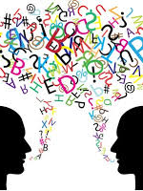
When Do We Communicate?
We communicate all the time, such as:
In class discussions and group work
During meetings or presentations
When texting or emailing
In social settings with friends and family
When we listen or observe others’ behavior
We communicate with every word we speak, every gesture we make and every action we take

Slide 4
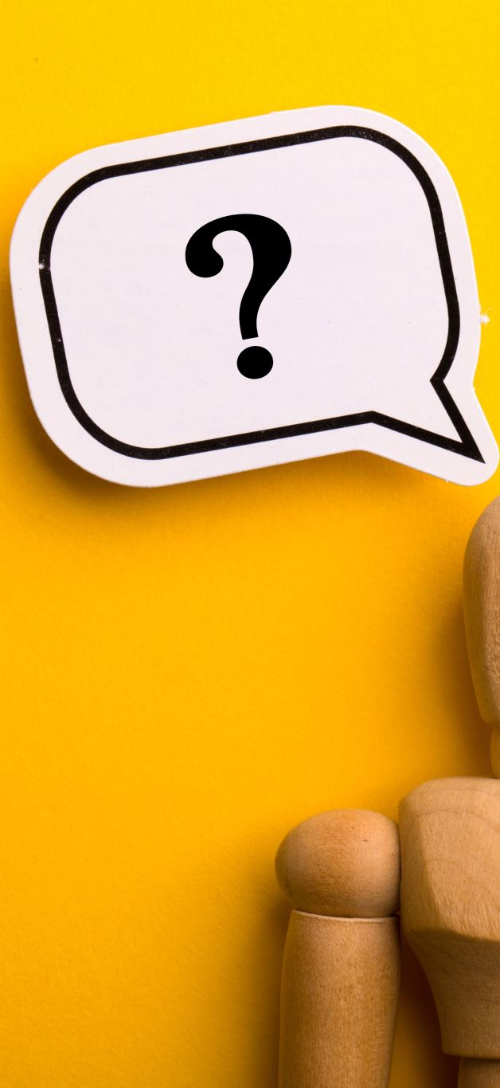
Why We Communicate
We communicate to:
Share information
Express emotions or opinions
Ask questions or clarify
Influence others or make decisions
Build and maintain relationships

Slide 5
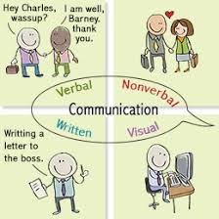
Channels of Communication
1. Verbal
2. Non Verbal
3. Written
4 Visual
Assignment: Go to google, search each of these terms. Enter the definition for each in the space in the table of your activity Packet. Then list at least 4 examples of each.

Slide 6
Tips For Verbal Communication
1. Speak Clearly and Confidently
Use a steady voice and pronounce words clearly.
Avoid mumbling or talking too fast.
2. Think Before You Speak
Organize your thoughts.
Make sure your message fits the situation.
3. Be Polite and Respectful
Use positive language and tone.
Avoid interrupting or using harsh words.
4. Listen Actively
Pay attention to others when they speak.
Respond with interest or questions.
5. Watch Your Tone and Body Language
Your voice and gestures can change how your words are received.
Smile, make eye contact, and use open posture.

Slide 7
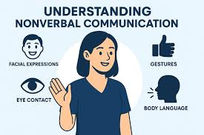
What Is Nonverbal Communication?
Nonverbal communication means sending messages without words.
It includes body movements, facial expressions, gestures, tone of voice, and appearance.
It often shows how a person feels more than what they say.

Slide 8

What Nonverbal Communication Communicates or Says
Facial Expressions – Show emotions like happiness, sadness, or anger.
Eye Contact – Shows attention, confidence, or interest.
Gestures – Movements of hands or arms that add meaning.
Posture and Body Movement – How we stand or move shows attitude or confidence.
Tone of Voice – The way something is said can change its meaning.
Appearance – Clothing and grooming can communicate respect or confidence.

Slide 9
Communication Can Be
Formal communication – school, work, meetings, interviews
Informal communication – chatting, texting, social media
One-on-one – conversations
Group or public – class presentations, team projects

Slide 10
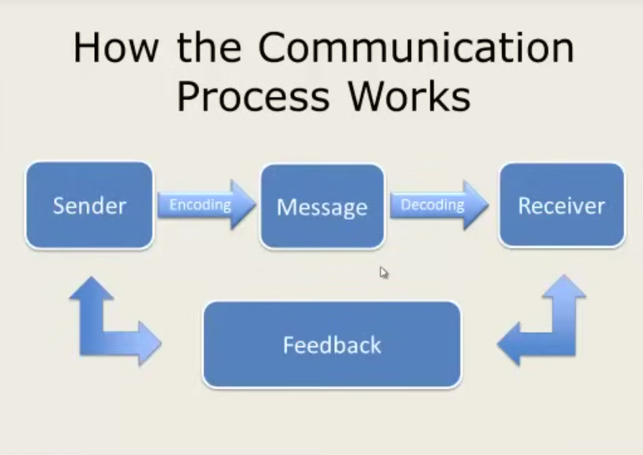
Communication Process

Slide 11

Communication process
Sender – The person who creates and sends the message.
Message – The information, idea, or feeling being shared.
Encoding – How the sender puts the message into words, symbols, or gestures.
Channel – The method used to send the message (talking, texting, email, etc.).
Receiver – The person who gets and interprets the message.
Decoding – How the receiver understands or interprets the message.
Feedback – The response or reaction that shows whether the message was understood.
Noise – Anything that blocks or interferes with communication (distractions, poor connection, misunderstanding, etc.).

